Slide 1
Introduction to Data Science

Slide 2
Start AI with Ethics
Microsoft believes that AI technology should embody the following principles:
Fair - AI must maximize efficiencies without destroying dignity and guard against bias
Accountable - AI must have algorithmic accountability
Transparent - AI must be transparent
Ethical - AI must assist humanity and be designed for intelligent privacy
https://tinyurl.com/learnai-AIEthics

Slide 3

Big Data
Breakthroughs
Enabling
AI
Powerful Algorithms
Cloud Computing
Notes:
Define AI: The ability of machines to use human-style reasoning and senses
AI and Data Mining have been around for some time – what makes it different now?

Slide 4
The Azure AI Landscape
Applications
Use AI
Artificial Intelligence in Applications
Cognitive services
Bot framework
Knowledge
Include AI
Artificial Intelligence from Pre-built Services, Apps, and Knowledge Mining
Machine Learning Services, Pretrained Models, Frameworks and Infrastructure, IoT
Create AI
Artificial Intelligence with Platforms, Infrastructure and Tools, Deploy to Edge
Azure Databricks, Azure Notebooks
AI Solutions Gallery
Find AI
Artificial Intelligence Solutions in a Portal
Notes:
The key is to progress through the quickest through the most customized. And to leverage what others have already developed.
Even backed in to the local operating system - https://docs.microsoft.com/en-us/windows/uwp/machine-learning/

Slide 5
Resource: AI-Landscape
https://tinyurl.com/LearnAI-Landscape

Slide 6
Use AI - Agent
Cortana
1,000+ skills and knowledge, 133 million users | 12 billion questions

Slide 7

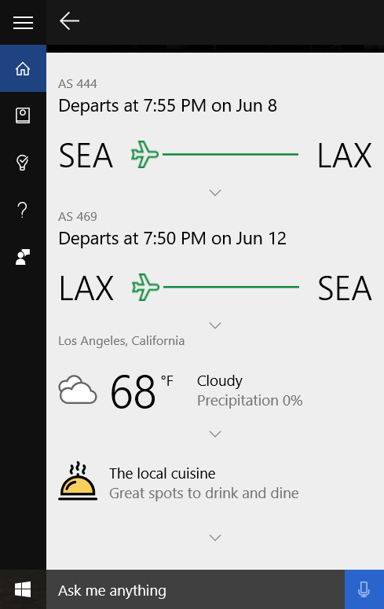

Slide 8
Use AI - Applications
Office 365
Skype
Dynamics 365
Teams
SwiftKey
Calendar.help
Pix
Customer Service and Support
Notes:
DEMO: Show Excel Flash-Fill from local drive

Slide 9
Resource: Flash-Fill and more
https://tinyurl.com/LearnAI-FlashFill
https://tinyurl.com/LearnAI-OfficeAI
Notes:
Show Flash-Fill demo, or run video

Slide 10
Include AI - Services
Cognitive Services
Cognitive Services Customizations
Bot Framework
Knowledge Mining

Slide 11






Microsoft Cognitive Services Give your apps a human side
Vision
From faces to feelings, allow your apps to understand images and video
Speech
Hear and speak to your users by filtering noise, identifying speakers, and understanding intent
Language
Process text and learn how to recognize what users want
Knowledge
Map complex information and data in order to solve specific tasks
Search
Access billions of web pages, images, videos, and news with the power of Bing
Labs
An early look at emerging Cognitive Services technologies: discover, try, and give feedback on new technologies before general availability

Slide 12
Microsoft Cognitive Services
Vision
Speech
Language
Knowledge
Search
Labs
Video Indexer
Speaker Recognition
Text Analytics
QnA Maker
Bing Entity Search
Project Gesture
Computer Vision
Bing Speech
Bing Spell Check
Azure Search
Bing Autosuggest
Project Local Insights
Face
Custom Speech
Translator Text
Bing Search
Project Academic Knowledge
Emotion
Translator Speech
Language Understanding (LUIS)
Web Search
Project Entity Linking
Content Moderator
Unified Speech
Custom Vision
Image Search
Project Knowledge Exploration
Custom Vision
Speech to Text w. Custom Speech
News Search
Project Event Tracking
Text to Speech w. Custom Voice
Video Search
Project Answer Search
Speech Translation w. Custom Translator
Bing Statistics add-in
Project URL Preview
Bing Visual Search
Project Anomaly Finder
Bing Custom Search
Project Conversation Learner
Project Personality Chat
Notes:
Vision: Image-processing algorithms to smartly identify, caption and moderate your pictures
Computer vision: Distill actionable information from images
Content Moderator: Automatically moderate potentially offensive images, text and videos
Customer Vision Service: Train a web service to recognize specific content in images
Face: Identify human faces and emotions in images
Video indexer: Easily extract insights from your videos to enrich your applications
Speech: Convert spoken audio into text, use voice for verification, or add speaker recognition to your app
Bing Speech: Convert speech to text and text to speech
Speaker Recognition: Use speech to identify and authenticate individual speakers
Custom Speech Service: Overcome speech recognition barriers like speaking style, background noise, and vocabulary
Translator Speech: Easily conduct real-time speech translation on your app
Language: Enable your apps to process natural language with pre-built scripts, evaluate sentiment and learn how to recognize what users want
Bing Spell Check: Add spell checking functionality to your app
Language Understanding (LUIS): Add language understanding intelligence to your apps with minimal effort
Linguistic Analysis: Easily parse complex text with language analysis
Text Analytics: Easily evaluate sentiment, language, and key phrases to understand what users want
Translator Text: Easily conduct machine translation for 60+ languages
Knowledge: Map complex information and data in order to solve tasks such as intelligent recommendations and semantic search
Knowledge Exploration Service: Enable interactive search experiences over structured data via natural language inputs
Entity Linking Service: Power your app's data links with named entity recognition and disambiguation
Academic Knowledge: Tap into the wealth of academic content in the Microsoft Academic Graph using the Academic Knowledge API
QnA Maker: Distill information into an easy-to-navigate FAQ for bot services
Customer Decision Service: Create custom experiences with adaptive, contextual decision-making
Search: Add Bing Search APIs to your apps and harness the ability to comb billions of webpages, images, videos, and news with a single API call
Bing Autosuggest: Give your app intelligent autosuggest options for searches
Bing News Search: Search for news and get comprehensive results
Bing Web Search: Get enhanced search details from billions of web documents
Bing Entity Search: Enrich your experiences by identifying and augmenting entity information from the web
Bing Image Search: Search for images and get comprehensive results
Bing Video Search: Search for videos and get comprehensive results
Bing Custom Search: Create tailored site search or vertical search experiences for topics you care about
Labs: Cognitive Services Labs are early preview limited availability leading innovation APIs and SDKs that allow developers to start experimenting with Microsoft’s latest and greatest Cognitive Services.
Project Prague: SDK to incorporate gesture-based controls into your apps. Quickly define and implement customized hand gestures, creating a more natural user experience. Limited private preview availability at launch.
Project Cuzco: API to help developers find events associated with Wikipedia entities. Begin with a Wikipedia entity, and receive a list of related events organized by time.
Project Johannesburg: API to calculate route logistics for with deeper location intelligence to account for specific enterprise requirements. IE: weight, height length, hazardous materials, etc.
Project Nanjing: API to calculate isochrones - time and distance-based recommendations for enterprise route optimization.
Project Abu Dhabi: API to create distance matrices, enabling you to calculate a histogram of travel times, and serve as stepping stone for enterprise route optimization.
Project Wollongong: API to help ‘score’ the attractiveness of a location, based on how many of a particular amenity are within a specific distance. Ex: restaurants, parks, transit stops.
With Cognitive Services, developers can easily add intelligent features – such as emotion and sentiment detection, vision and speech recognition, knowledge, search and language understanding – into their applications. The collection will continuously improve, adding new APIs and updating existing ones.
Cognitive Services includes:
<click>
Vision: From faces to feelings, allow apps to understand images and video
<click>
Speech: Hear and speak to users by filtering noise, identifying speakers, and understanding intent
<click>
Language: Process text and learn how to recognize what users want
<click>
Knowledge: Tap into rich knowledge amassed from the web, academia, or your own data
<click>
Search: Access billions of web pages, images, videos, and news with the power of Bing APIs
Why choose these APIs? They work, and it’s easy.
<click>
Easy: The APIs are easy to implement because of the simple REST calls. There’s a common way to implement, and you can get started with all of them for free simply by going to one place, one website, www.microsoft.com/cognitive.
Flexible: We’ve got a breadth of intelligence and knowledge APIs so developers will be able to find what intelligence feature they need. And, importantly, they all work on whatever language, framework, or platform developers choose. So, developers can integrate into their apps—iOS, Android, Windows—using their own tools they know and love.
Tested: Tap into an ever-growing collection of powerful AI algorithms developed by experts. Developers can trust the quality and expertise build into each API by experts in their field from Microsoft’s Research organization, Bing, and Azure machine learning and these capabilities are used across many Microsoft first party products such as Cortana, Bing and Skype.
Transition: When it comes to real-world applications for Cognitive Services, the sky is the limit! Let’s look at some examples.
<click>

Slide 13
Search
Bing Search
Bing Visual Search
Bing Entity Search
Web Search
Image Search
News Search
Video Search
Get rich insights to help build compelling image applications on the device of your choice
Enrich user experiences with contextual entity search results
Bing Autosuggest
Bing Custom Search
Give your app intelligent autosuggest options for searches
Create a highly-customized web search experience
Bing Statistics add-in
Get powerful Bing API usage insights in an easy-to-use add-in
Notes:
The Search APIs provide access to the search technology that power Bing.com and a long list of 1st-party (Office, Cortana, Xbox, Edge) and 3rd-party partners. In total, we have 4 Search APIs for web, image, video and news search. In addition we provide access to our Autosuggest (type-ahead) and Spell Check services.
Bing Web Search API: is the main Search API. With one programmatic call, the user can get back relevant webpage, image, video, and news results. It's equivalent to searching in the web vertical in bing.com. The Search APIs provide the power of the Bing Search engine to developers. You get access to many of the latest and greatest capabilities the bing.com site has to offer, in the form of an API. It's the same architecture stack so it's a powerful way to bring the knowledge and intelligence of the search engine to your own experience. The API is built directly on top of the entire Bing stack- you get the quality, relevance, performance and continuous improvements that the rest of the site gets. Similar to Bing.com- tail queries, or obscure terms may have limited results. We're always working to improve the edge cases though and API users will benefit from that.
Bing Image Search API: Help users scour the web for images. Results include thumbnails, full image URLs, publishing website info, image metadata, and more. Try out the demo.
Bing Video Search API: Find videos across the web. Results provide useful metadata including creator, encoding format, video length, view count, and more
Bing News Search API: Search the web for news articles. Results include details like authoritative image of the news article, related news and categories, provider info, article URL, and date added
Bing Autosuggest API: Help users complete queries faster by adding intelligent type-ahead capabilities to your app or website. Empower users to type less and do more with automated and complete search suggestions.
Bing Custom Search: lets you create a highly-customized web search experience, which delivers better and more relevant results from your targeted web space. Featuring a straightforward User Interface, Bing Custom Search enables you to create your own web search service without a line of code. Specify the slices of the web that you want to draw from and explore site suggestions to intelligently expand the scope of your search domain. Bing Custom Search can empower businesses of any size, hobbyists and entrepreneurs to design and deploy web search applications for any possible scenario.
Bing Entity Search API - Search for the most relevant entity
Harness the power of the web with the Bing Entity Search API. You can enrich your app by infusing knowledge search into existing content. Bing Entity Search API will identify the most relevant entity based on your searched term, spanning multiple entity types such as famous people, places, movies, TV shows, video games, books, and even local businesses near you.
Bing Visual Search - a new service in general availability that lets you harness the capabilities of Bing Search to perform intelligent search by image capabilities, such as searching similar products for a given product (e.g. in retail scenario, wherein user would like to see products similar to the one being considered), identifying barcodes, text, celebrities and more!
Bing Statistics-add-in - an add-in which provides various metrics and rich slicing and dicing capabilities for several Bing APIs

Slide 14
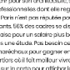


Knowledge Mining with Azure Search
Documents
AI Components
Full text-searchable rich index
Key Phrase extraction
Location entity extraction
Sentiment analysis
Organization entity extraction
Persons entity extraction
Language detection
TPS Reports
Face detection
Celebrity recognition
Tag extraction
Custom skills
Landmark detection
Printed text recognition
https://tinyurl.com/learnai-AzureSearch
Notes:
You can take Azure Cognitive Search and you can run all of the cognitive services we’ve been talking about to go and do:
Facial recognition to recognize people in images
Named entity detection to understand what blocks of text mean
Language detection and translation etc.
Then you put all this information into an index, and run azure search on top of it.
Content intelligently turns into text, becomes a searchable index
(Makes un-searchable content searchable)
AI algorithms added to the indexing pipeline (data in Azure)
https://docs.microsoft.com/en-us/azure/search/cognitive-search-quickstart-blob

Slide 15
Resource: Vision Demo
and Code Bootcamp
https://tinyurl.com/LearnAI-CustomVisionDemo
https://tinyurl.com/LearnAI-CustomVisionBootcamp

Slide 16

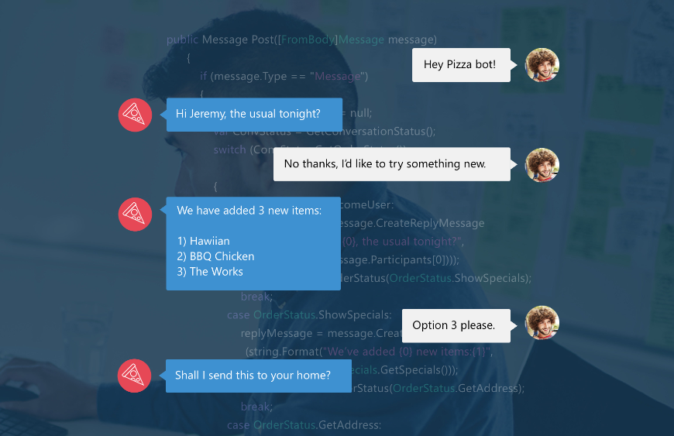
Bot Framework - Engage with your users
A natural language interface across all conversation channels
Insights
Operationalization
Provide information
Perform tasks
Make recommendations
Capture information

Slide 17






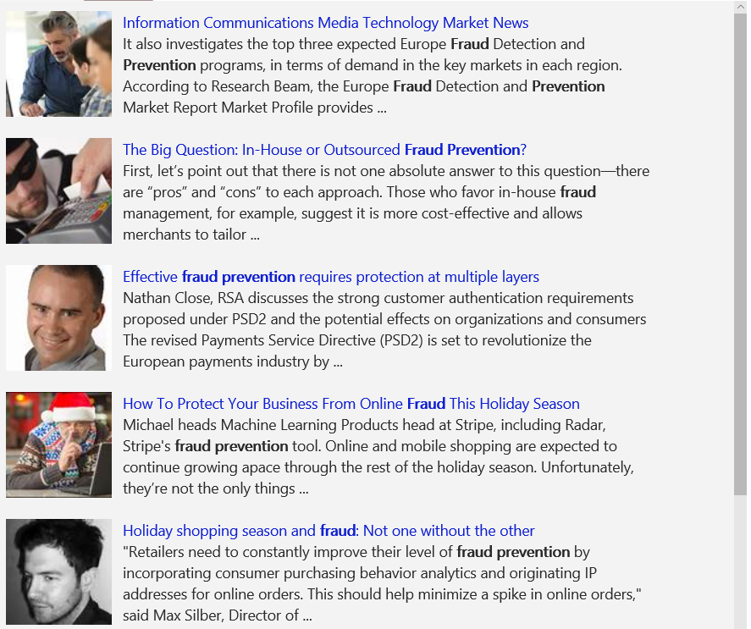
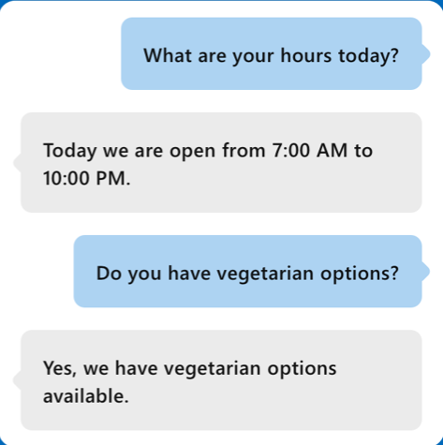
Combining Services for real-world applications
Vision
Speech
Language
Knowledge
Search
What is in the image or video?
Give me directions to the nearest local branch
Play today’s customer call recording
QnA Pair of this site?
Search for ‘fraud prevention’
Intelligent Image insights
Speech to text
Natural Language Processing
Automatic extraction of questions and answers
Intelligent web search
Information Communications Media Market News
It also investigates the top three expected Fraud Detection and Prevention programs, in terms of demand in key markets…
Intent: PlayCall
Content: Customer#
DateTime.date: today
The Big Question: In-House or Outsourced Fraud Protection?
First, let’s point out that there is not one absolute answer—there are “pros” and “cons” to each. Those who favor in-house…
Category | People; 5 faces
Adult/Racy? | False/False
Dominant colors
Accent color
Convert spoken audio to text
How to Protect Your Business from Online Fraud this Holiday Season
Michael heads fraud prevention tool. Online and mobile shopping are expected to continue growing apace…
Computer Vision
Speech Service
Language Understanding
QnA Maker
Bing News Search
Convert text to spoken audio
Now Playing
Extract intent of user
11/29/2016 Customer Call
Notes:
Cognitive services span Vision, Speech, Language, Knowledge, and Search. Combining many of these services together can either improve user interaction models, or provide fun and engaging user experiences.
Our examples here shine some light on how some of these APIs work in real-world situations:
Vision
The Computer Vision API is able to extract rich information from images to categorize and process visual data and protect your users from unwanted content. Here, the API is able to tell us what the photo contains, indicate the most common colors, and lets us know that the content would not be considered inappropriate for users.
Speech
The Bing Speech API is capable of converting audio to text, understanding intent, and converting text back to speech for natural responsiveness. This case shows us that the user has asked for directions verbally, the intent has been extracted, and a map with directions provided.
Language:
Language Understanding Intelligent Service, known as LUIS, can be trained to understand user language contextually, so your app communicates with people in the way they speak. The example we see here demonstrates Language Understanding’s ability to understand what a person wants, and to find the pieces of information that are relevant to the user’s intent.
Knowledge
Knowledge Exploration Service adds interactive search over structured data to reduce user effort and increase efficiency. Our Knowledge Exploration API example here demonstrates the usefulness of this API for answering questions posed in natural language in an interactive experience.
Search
Bing Image Search API enables you to add a variety of image search options to your app or website, from trending images to detailed insights. Users can do a simple search, and this API scours the web for thumbnails, full image URLs, publishing website info, image metadata, and more before returning results.
Transition: These APIs are available as stand-alone solutions, or as part of the Cortana Intelligence Suite. They can also be used in conjunction with the Microsoft Bot Framework.
<click>

Slide 18
Resource: Bot Bootcamp
https://tinyurl.com/LearnAI-BotBootcamp

Slide 19
Create AI - Infrastructure and Tools
Data Science Process
Pretrained Models
Azure Databricks
Services and Frameworks
Infrastructure
Notes:
Show this page as an example: https://blogs.technet.microsoft.com/machinelearning/2018/03/07/using-microsoft-ai-to-build-a-lung-disease-prediction-model-using-chest-x-ray-images/

Slide 20
The Data Science Process
Business Understanding
Define Objectives
Identify Data Sources
Data Acquisition and Understanding
Ingest Data
Explore Data
Update Data
Modeling
Feature Selection
Create and Train Model
Deployment
Operationalize
Customer Acceptance
Testing and Validation
Handoff
Re-train and re-score
aka.ms/tdsp
Notes:
Data Science Blog - https://buckwoody.wordpress.com/

Slide 21






Machine Learning on Azure
Sophisticated pretrained models
To accelerate solution development with easy to use pretrained models
…
Vision
Speech
Language
Search
Cognitive Services
Popular frameworks
Build sophisticated deep learning solutions
Pytorch
TensorFlow
Keras
Onnx
Productive services
Empower your development teams
Azure Databricks
Azure Machine Learning
Machine Learning VMs
Powerful infrastructure
Accelerate time to value
CPU
GPU
FPGA
Notes:
Azure Machine Learning services
Machine learning at big data scale
Container based AI deployment from cloud to edge
Rapid, scale out, collaborative experimentation
AI powered data wrangling
Spark, Docker, Cognitive Toolkit, TensorFlow, Caffe, and more
Azure Databricks
Bring teams together in an interactive workspace. From data gathering to model creation, use Databricks Notebooks to unify the process and instantly deploy to production. Launch your new Spark environment with a single click. Integrate effortlessly with a wide variety of data stores and services such as Azure SQL Data Warehouse, Azure Cosmos DB, Azure Data Lake Store, Azure Blob storage, Azure Event Hubs, Azure IoT Hub, and Azure Data Factory. Add advanced artificial intelligence (AI) capabilities instantly and share your insights through rich integration with Power BI.
Other Ignite Sessions -

Slide 22






Popular Frameworks
Use your favorite deep learning frameworks
without getting locked into one framework
TensorFlow
PyTorch
Scikit-Learn
ONNX
Community project created by Microsoft and Facebook
Use the best tool for the job. Train in one framework and transfer to another for inference
MXNet
Chainer
Keras
Notes:
Microsoft Azure can support 3rd party and Open source frameworks. On top of this
ONNX – Open Neural Network Exchange
the Open Neural Network Exchange (ONNX) format in conjunction with Facebook. ONNX provides a shared model representation for interoperability and innovation in the AI framework ecosystem. Cognitive Toolkit, Caffe2, and PyTorch will all be supporting ONNX. Microsoft and Facebook co-developed ONNX as an open source project, and we hope the community will help us evolve i
ONNX provides a definition of an extensible computation graph model, as well as definitions of built-in operators and standard data types. Initially we focus on the capabilities needed for inferencing (evaluation).
Each computation dataflow graph is structured as a list of nodes that form an acyclic graph. Nodes have one or more inputs and one or more outputs. Each node is a call to an operator. The graph also has metadata to help document its purpose, author, etc.
Operators are implemented externally to the graph, but the set of built-in operators are portable across frameworks. Every framework supporting ONNX will provide implementations of these operators on the applicable data types.

Slide 23

Azure ML/AI Infrastructure
CPUs
GPUs
FPGAs
G
Ev3
M
NC
NCv2
NV
ND
FPGA
NCv3
NVv2
NDv2
(coming soon)
(coming soon)
Notes:
Microsoft compute capabilities have the capacity for even the most intense computing requirements. Currently supporting CPUs and GPUs in production Microsoft will also release new capabilities using FPGAs (Field Programmable Gate Arrays)
.
PGAs, in this case, Intel’s Stratix 10 devices, makes it possible to achieve extremely low latency for inferencing requests – even better than custom-built ASICs designed for machine learning. Just as important is the ability of the FPGAs to be reconfigured for different types of machine learning models – LSTMs, CNNs, GRUs, and so on. This flexibility makes it easier to accelerate the application based on the most optimal numerical precision and memory model being used. The reconfigurability is also a form of future-proofing, given that new machine learning techniques are being developed on a pretty regular basis.

Slide 24
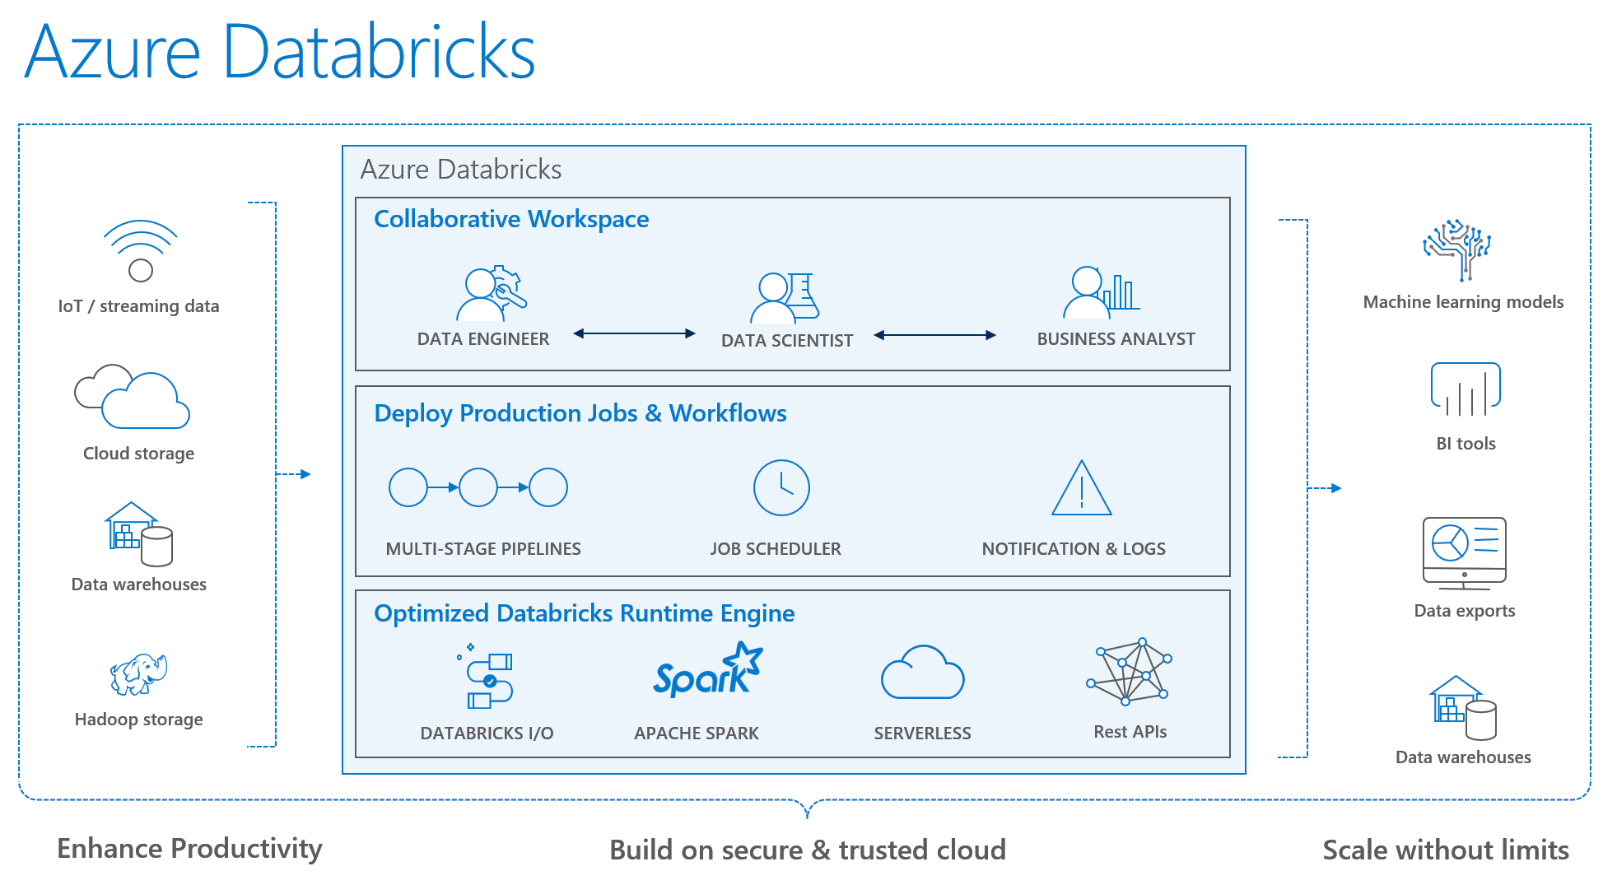
Notes:
Databricks differs from HDI in that HDI is a PaaS-like experience that allows working with many more OSS tools at a less expensive cost.
Databricks advantage is it is a Software-as-a-Service-like experience (or Spark-as-a-service) that is easier to use, has native Azure AD integration, has auto-scaling and auto-termination (like a pause/resume), has a workflow scheduler, allows for real-time workspace collaboration, and has performance improvements over traditional Apache Spark.

Slide 25
Flexible deployment Deploy and manage models on intelligent cloud and edge
Train & deploy
Train & deploy
Track models in production
Capture model telemetry
Retrain models automatically
Deploy
Notes:
We are the only company that offers ability to deploy and manage models whether in the cloud, on-premises or even the edge.
This is extremely valuable in disconnected scenarios where predictions have to be made on the edge w/o connectivity to the cloud.
With IoT deployments becoming more widespread, we are well positioned to help our customers innovate with AI wherever they want.
So, you should be excited with our Machine Learning portfolio.

Slide 26
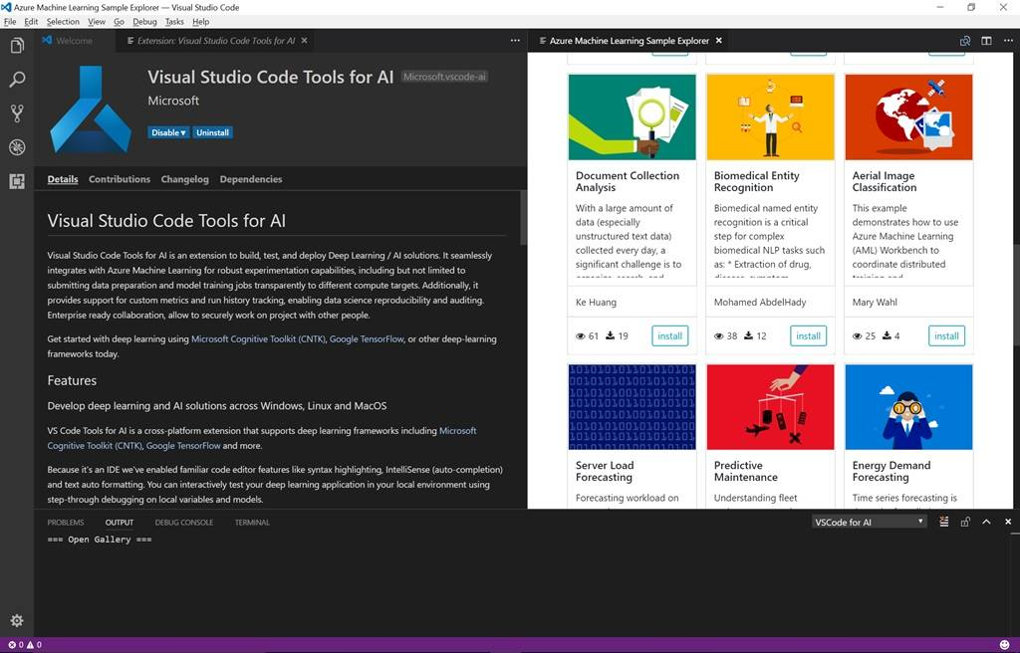
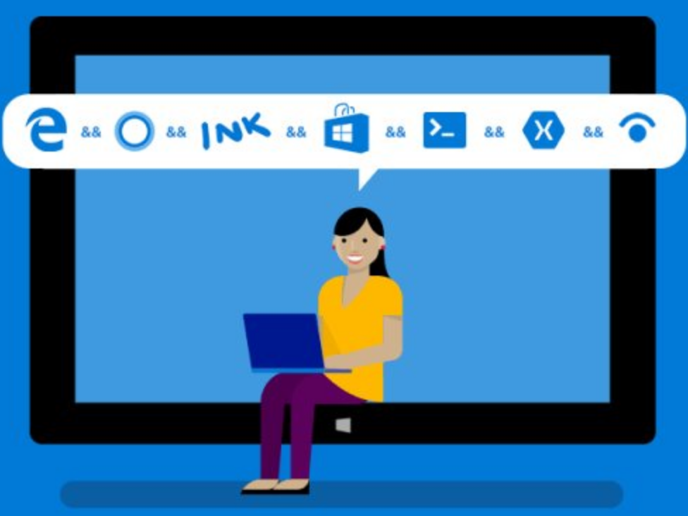
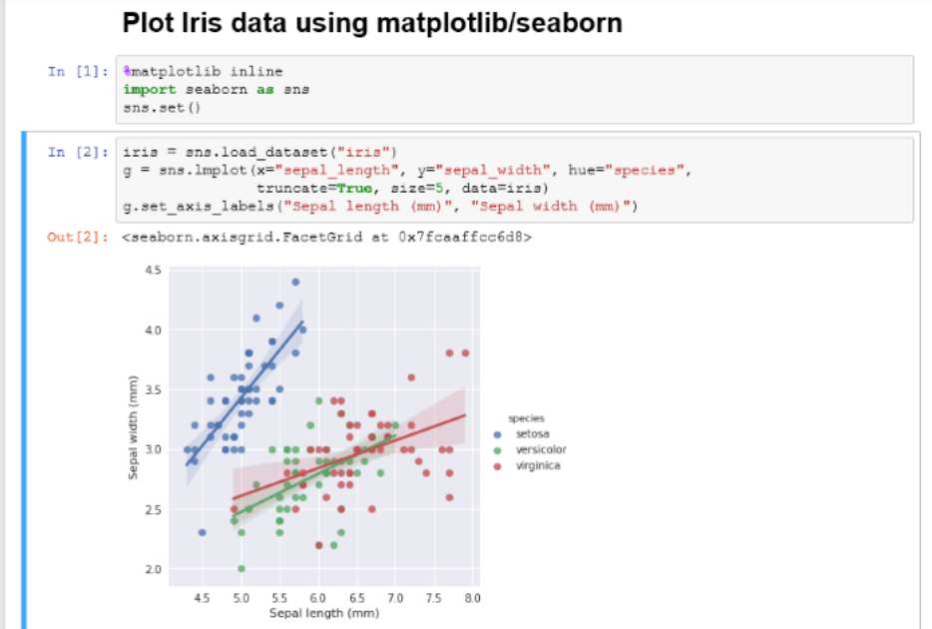
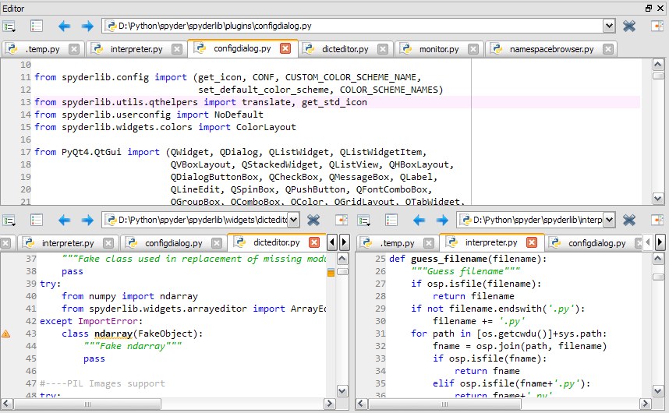
Development Tools: Jupyter, VS Code, Visual Studio, and 3rd Party,
SDK’s and R/Python Packages
(All available on the Azure Data Science Virtual Machine)
https://tinyurl.com/LearnAI-DSVM
Notes:
Data Science Blog - https://buckwoody.wordpress.com/

Slide 27
Resource: Professional AI Developer
Bootcamp
https://azure.github.io/LearnAI-Bootcamp/

Slide 28
Find AI - Solution Portal

Slide 29
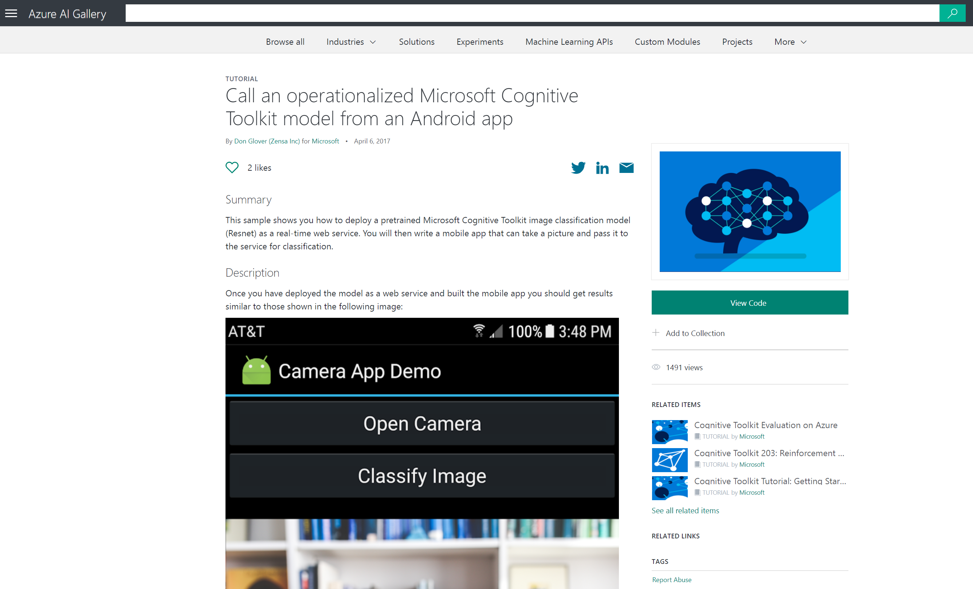
Notes:
Demo:
Show Gallery: https://docs.microsoft.com/en-us/azure/machine-learning/studio/gallery-how-to-use-contribute-publish
Show: https://gallery.azure.ai/browse?categories=[%2210%22]&orderby=freshness%20desc
Show: Filtering
Show Try It: https://gallery.azure.ai/Solution/Fraud-Detection-with-Azure-HDInsight-Spark-Clusters-2

Slide 30
Resource: AI Gallery
https://gallery.azure.ai

Slide 31
Overview of Machine Learning
Machine Learning is not
Methods and Systems that …
put garbage in and get knowledge out
perform good predictions without data modeling & feature engineering
silver-bullet for all data-driven tasks
replace business rules

Slide 32
Practical Machine Learning

Slide 33
What is Machine Learning?
Machine learning is a data science technique that allows computers to use existing data to forecast future behaviors, outcomes, and trends.
Using machine learning, computers learn without being explicitly programmed.

Slide 34
Overview of Machine Learning
Machine Learning is
Methods and Systems that …
Adapt based on recorded data
Predict new data based on recorded data
Optimize an action given a utility function
Extract hidden structure from the data
Summarize data into concise descriptions

Slide 35
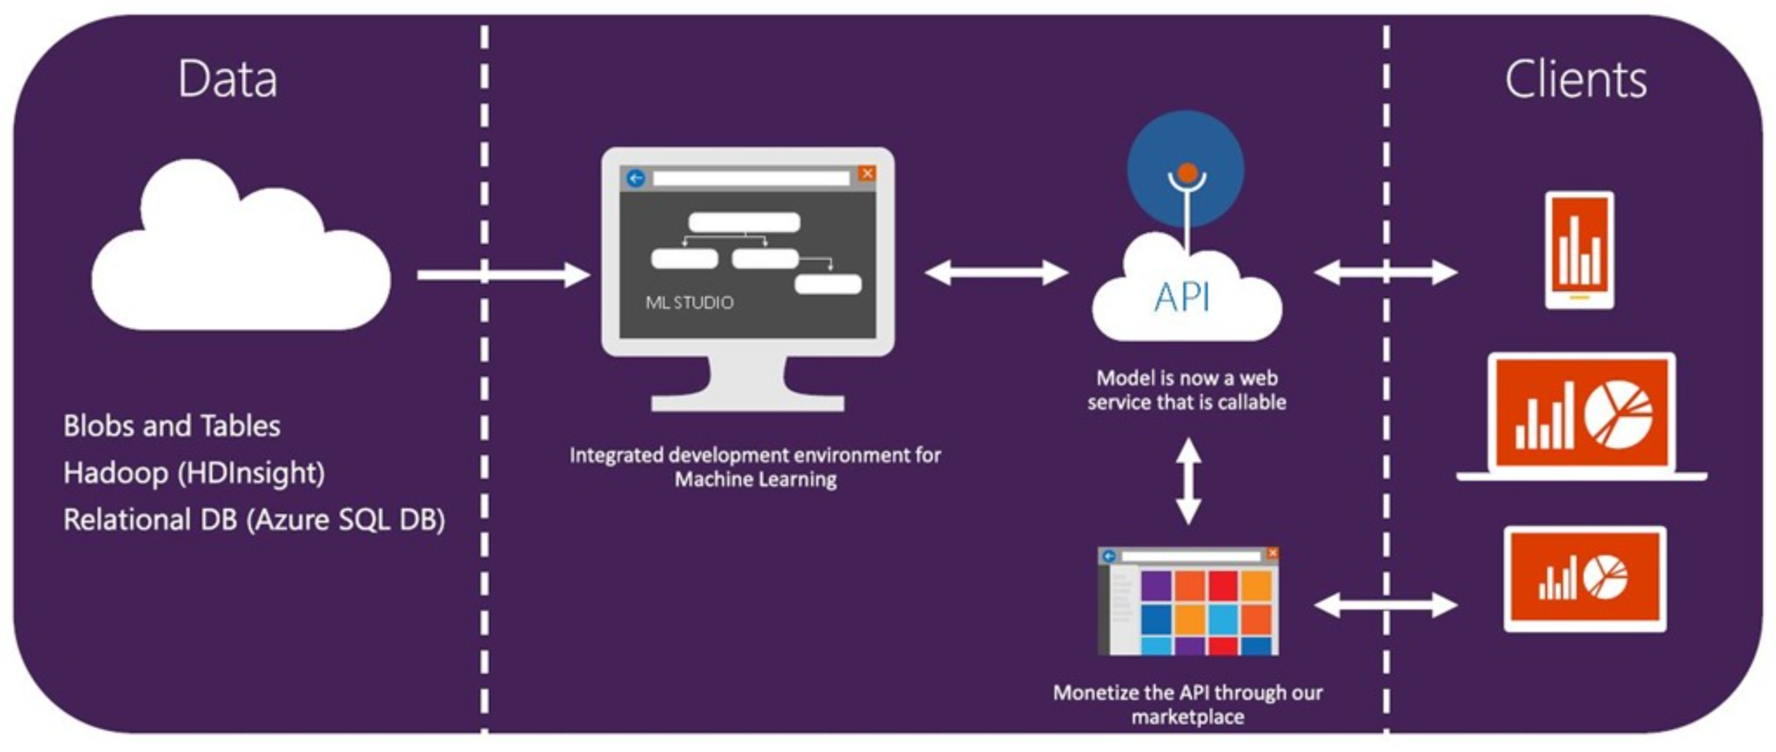
Basic Azure Machine Learning Workflow

Slide 36
Machine Learning on Microsoft Azure
Powerful cloud-based predictive analytics service
Fully-managed service you can use to deploy your predictive models as ready-to-consume web services
Tools for creating complete predictive analytics solutions in the cloud

Slide 37
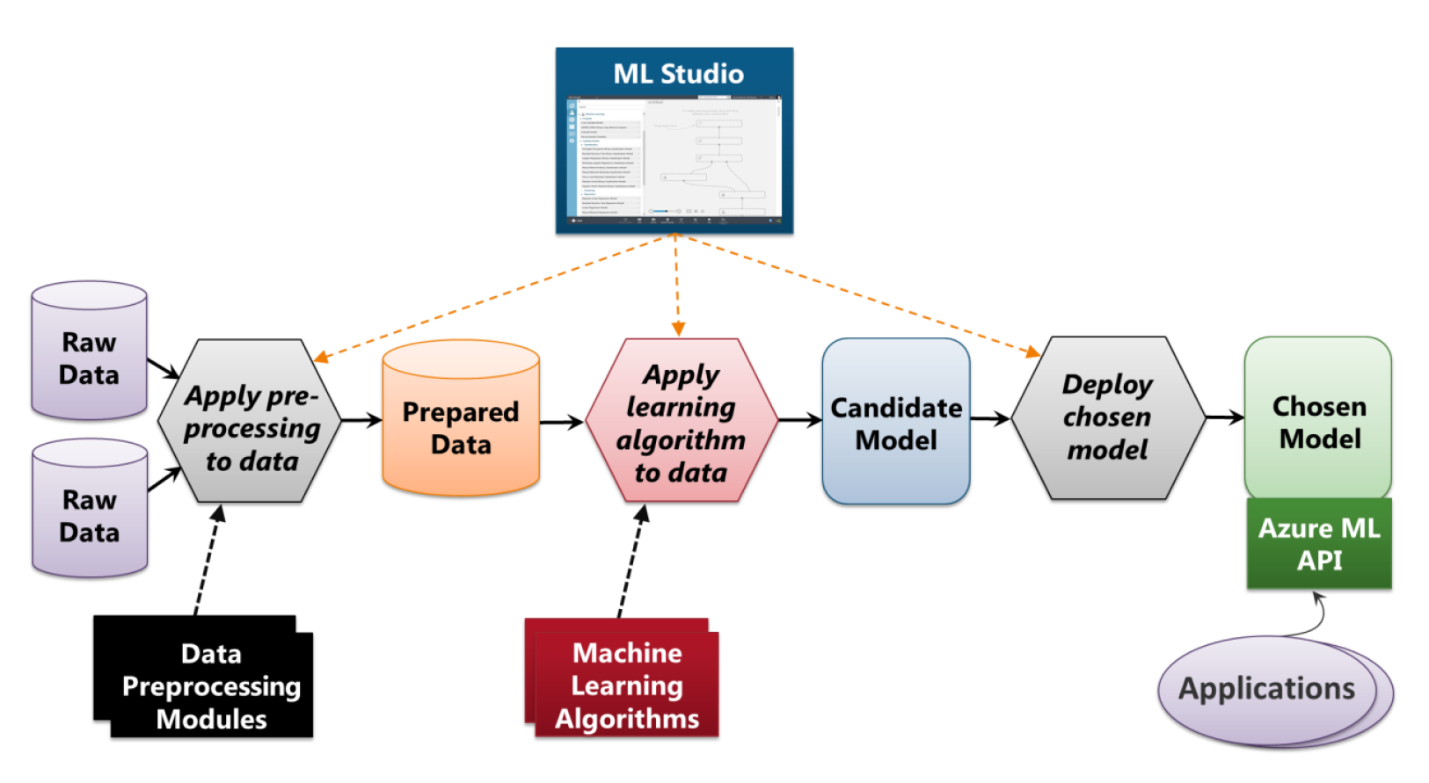
Azure Machine Learning Studio
Azure ML Studio provides a graphical tool for managing the machine learning process, a set of data pre-processing modules, a set of machine learning algorithms, and an API to expose the model to applications

Slide 38
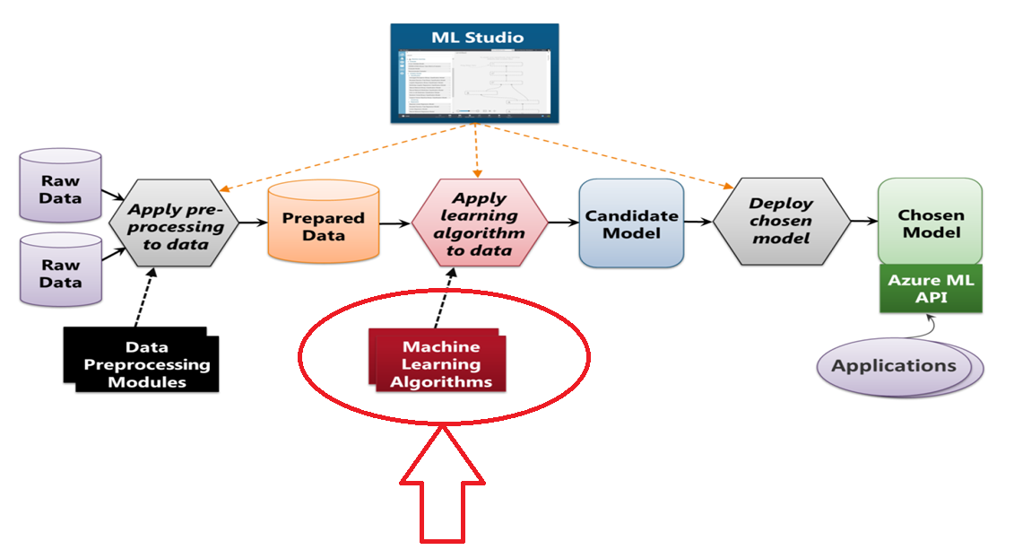
Main Azure ML Algorithms

Slide 39
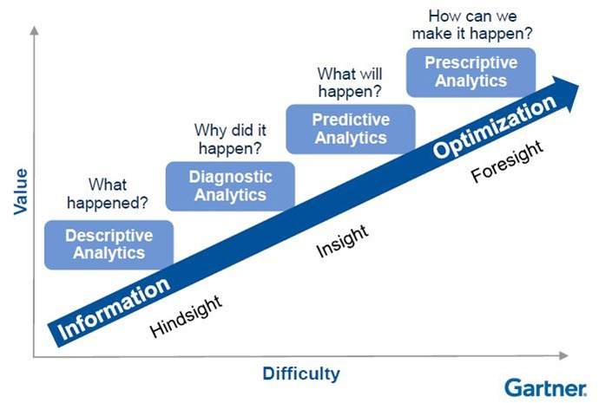
Types of Analytics
Traditional BI
Deployed ML
Notes:
See http://www.biganalytics2013.com/presentations/Neil-Raden-Big-Data-Analytics-The-Art-of-Data-Science.pdf – p7

Slide 40

What is Data Science
Data science is about using data to make decisions that drive goals and actions.
Use data analytics to:
Replace intuition with data driven analytical decisions
Transform raw data to valuable assets
Increase pace of action

Slide 41
What is Data Science
It is a process, it involves
Finding data
Acquiring data
Cleansing and transforming data
Understanding relationships in data
Delivering value from data

Slide 42

What is Data Science
The end goal is to create models to use mathematics to execute smart, factually based, micro-business decisions.
If this was Vegas we would call it intelligent gambling

Slide 43
Data Science Team Roles
IT/Data
Math
Data Science
Data Science is the practice of deriving information and insight from real-world data to create business value.

Slide 44
The Two Types of Data Scientist
1st – DBA/BI background/Developer
Understands historical reporting
Has an understanding of mathematics
May not have a degree in mathematics
Understands data and relationships
Familiar with concepts of marrying data from disparate systems
Understands ETL processes and tools
Understands to deploy or invoke a model (SQL or Application)
Understands how business and data relate
*ETL = Extract Transform and Load

Slide 45
The Two Types of Data Scientist
2nd– Mathematics background
Understands linear algebra
Understands calculus
Has at least a bachelors degree in mathematics and preferably a Masters
Understands slope, slope of a plane, linear fit
How to train models and utilized different algorithms
Reads academic white papers to understand how to interpret the findings and repeat the process

Slide 46
Data Science Team Roles
IT/Data
Math
Data Science
Data Science is the practice of deriving information and insight from real-world data to create business value.

Slide 47
Data Science Team Roles
The number of each role you need will be determined by the organization
Individuals that cover both roles are rare – aka Unicorns
Each Role is incredibly important
*Data Janitor work makes up 60% - 80% of every project

Slide 48
Data Science Process Walk Through
7
Deploy/Consume Model in Product
1
Define Business Problem and Planning
Acceptable Model
6
2
Train/Retrain ML Models
Plan and Prepare Environments
Iterate
Data Source
5
3
Pipeline
Deploy/Consume Model in Product
Ingest Data Into Data Platform
Data Format
4
Exploratory data analysis. Deploy/Consume Model in Product
Analytics
Notes:
A data science process for building and deploying a predictive solution typically involves the following
steps (see also Figure 3-1):
1. Defining the business problem, identifying the technologies suitable for the solution, and establishing key performance indicators (KPIs) for measuring success of the solution.
2. Planning and preparing the platform and environment on which the solution will be built (for example, SQL Server R services).
3. Data ingestion from a source to the environment. (Data cleansing is often needed.) Considerations
for data ingestion include the following:
• Data: on-premises or cloud; database or files; small, medium, and big data
• Pipeline: streaming or batch; low or high frequency
Format: structured or unstructured; data validation and clean-up
• Analytics: on-premises or cloud; database or data lake
4. Exploratory data analysis, summarization, and visualization. Methods can include the following:
• Data dimensions, types, statistical summary, missing values
• Distribution, histogram, boxplot, relationships, and so on
• Statistical significance (t-test), fit (chi-squared test), and so on
5. Identifying the dependent (target) and independent variables (also referred to as predictors or
features). Generating and/or selecting the features on which a predictive model will be created.
6. Creating predictive models using statistical and/or machine learning algorithms. Evaluating such
models for accuracy. If the accuracy is not appropriate for deploying the model, you can reiterate
steps 4, 5, and 6.
7. Saving and deploying the model into a predictive service for consumption.
F

Slide 49
Key Concepts of Machine Learning
Supervised Learning - Labeled (Most Common)
Process of applying a predictive model to predict a target feature based on a set of input features
Learning from data with the goal to predict the value of an outcome measure based on a number of input measures.
The outcome variable is known and guiding the learning process
Unsupervised Learning - Unlabeled
Process of applying a descriptive model in order to gain new insight and pattern from the data
Observe only the features and have no measurements of the outcome
Describe how the data is organized or clustered
No variable to predict
Examples: clustering, pattern detection

Slide 50
Azure Machine Learning Studio
Azure ML Studio provides a graphical tool for managing the machine learning process, a set of data pre-processing modules, a set of machine learning algorithms, and an API to expose the model to applications

Slide 51
Main Azure ML Algorithms

Slide 52
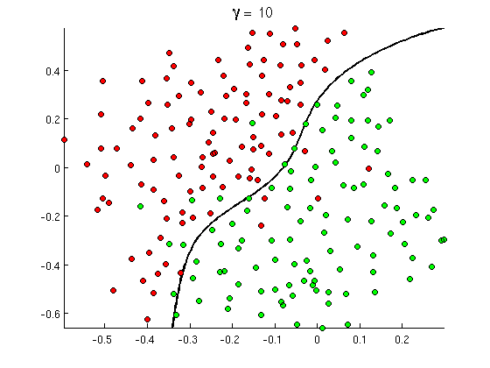
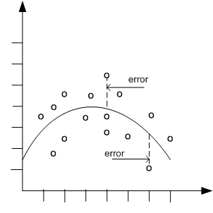

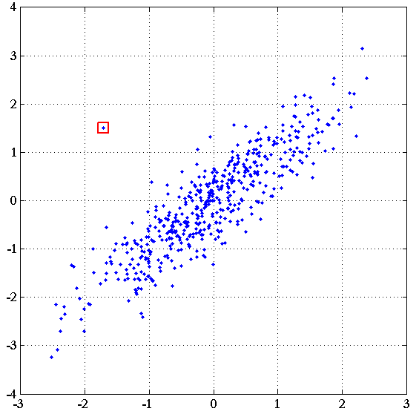
Common Classes of Problems
Classification
Regression
Recommenders
(Clustering)
Anomaly
Detection
Notes:
http://openclassroom.stanford.edu/MainFolder/courses/MachineLearning/exercises/ex8materials/ex8b_10.png
http://docs.oracle.com/cd/B28359_01/datamine.111/b28129/img/scatter_plot_nonlinear.gif
http://spectrum.ieee.org/img/RecommendNEWf1-1348253703748.jpg

Slide 53
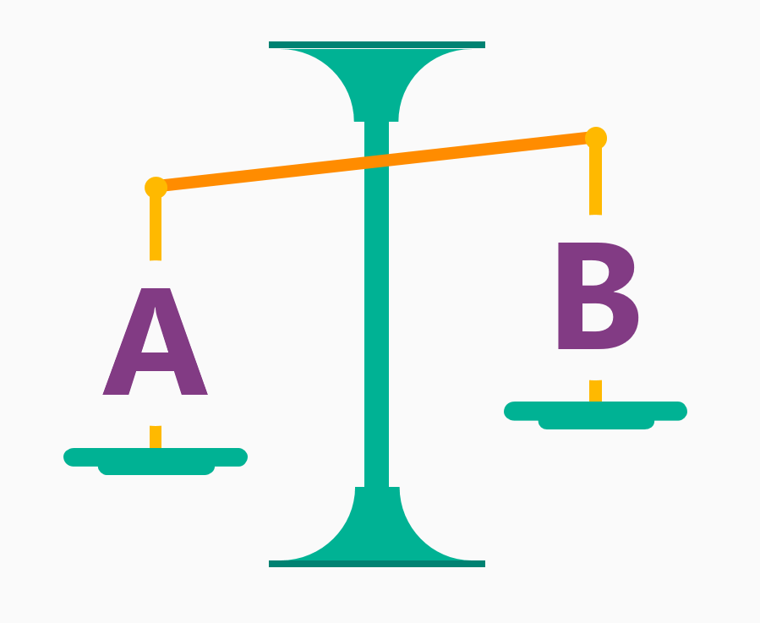
Classification Algorithms
Is it A or B?
Two-class classification algorithm
Useful for any question that has just two possible answers.
For example:
Will this tire fail in the next 1,000 miles: Yes or no?
Which brings in more customers: a $5 coupon or a 25%?

Slide 54
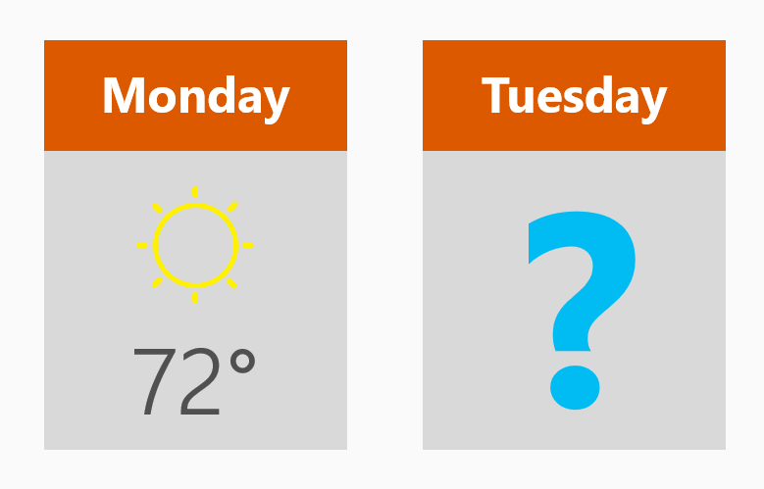
Regression Algorithms
How much? How many?
Regression algorithms make numerical predictions, such as:
What will the temperature be next Tuesday?
What will my fourth quarter sales be?
They help answer any question that asks for a number

Slide 55
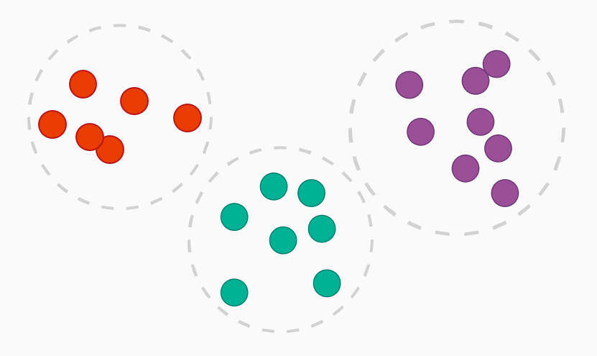
Clustering Algorithms
How is this organized?
Common examples of clustering questions are:
Which viewers like the same types of movies?
Which printer models fail the same way?
Which famous people have had similar careers?
Which text documents are similar to one another?
By understanding how data is organized, you can better understand - and predict – behaviors and events

Slide 56
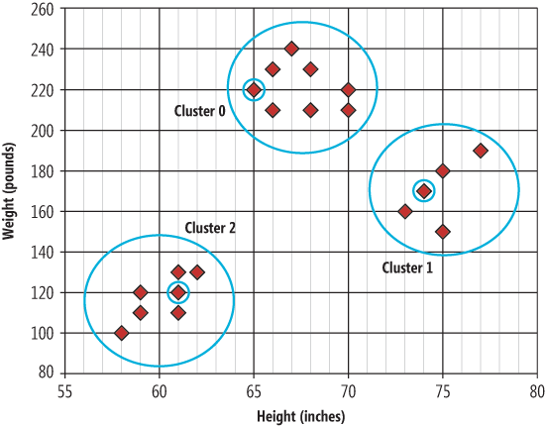
Unsupervised Learning
Notes:
In unsupervised learning, data points have no labels associated with them. Instead, the goal of an unsupervised learning algorithm is to organize the data in some way or to describe its structure. This can mean grouping it into clusters or finding different ways of looking at complex data so that it appears simpler or more organized.
Clustering Algorithms
Clustering uses unsupervised learning to group data into distinct classes. A major difference between clustering and classification problems is that the outcome of clustering is unknown beforehand. Before clustering we do not know the cluster to which
each data point belongs.
Clustering models identify relationships in a dataset that you might not logically derive through casual observation. For example, you can logically discern that people who commute to their jobs by bicycle do not typically live a long distance from where they work. The algorithm, however, can find other characteristics about bicycle commuters that are not as obvious. In the following diagram, cluster A represents data about people who tend to drive to work, while cluster B represents data about people who tend to ride bicycles to work.
http://msdn.microsoft.com/en-us/library/ms174879.aspx

Slide 57

Anomaly Detection Algorithms
Is this weird?
If you have a credit card, you’ve already benefited from anomaly detection
Your credit card company analyzes your purchase patterns, so that they can alert you to possible fraud.
Charges that are "weird" might be a purchase at a store where you don't normally shop or buying an unusually pricey item

Slide 58
Anomaly Detection Algorithms
This question can be useful in lots of ways. For instance:
If you have a car with pressure gauges, you might want to know: Is this pressure gauge reading normal?
If you're monitoring the internet, you’d want to know: Is this message from the internet typical?
Anomaly detection flags unexpected or unusual events or behaviors.
It gives clues where to look for problems.

Slide 59
Reinforcement Learning Algorithms
What should I do now?
Questions it answers are always about what action should be taken - usually by a machine or a robot.
Examples:
If I'm a temperature control system for a house: Adjust the temperature or leave it where it is?
If I'm a self-driving car: At a yellow light, brake or accelerate?
For a robot vacuum: Keep vacuuming, or go back to the charging station?
Reinforcement learning algorithms gather data as they go, learning from trial and error.

Slide 60
Create Model in Azure ML Studio
Create a Model
Get data
Pre-process data
Define features
Train the Model
Choose and apply a learning algorithm
Score and Test the Model
Predict over new data
Notes:
A Machine Learning Studio experiment consists of dragging components to a canvas, and connecting them in order to create a model, train the model, and score and test the model. The experiment uses predictive modeling techniques in the form of Machine Learning Studio modules that ingest data, train a model against it, and apply the model to new data. You can also add modules to preprocess data and select features, split data into training and test sets, and evaluate or cross-validate the quality of your model.

Slide 61
Let’s put it all together…
Ask the right question
Choose the right data
And get the data into good shape
Remove duplicates, understand missing data
Iterate until you have a model that makes good predictions
Deploy the model
When necessary, re-build and re-deploy the model
(Rinse and Repeat)
Notes:
A Machine Learning Studio experiment consists of dragging components to a canvas, and connecting them in order to create a model, train the model, and score and test the model. The experiment uses predictive modeling techniques in the form of Machine Learning Studio modules that ingest data, train a model against it, and apply the model to new data. You can also add modules to preprocess data and select features, split data into training and test sets, and evaluate or cross-validate the quality of your model.

